Slide 1
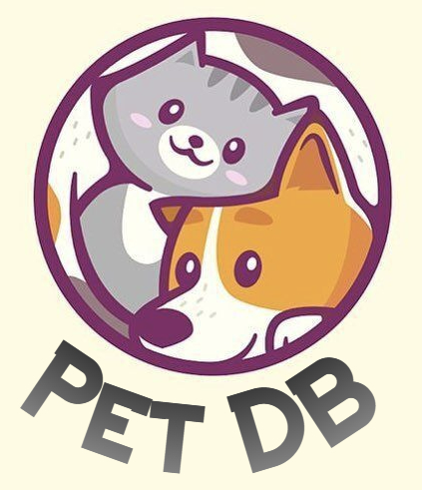
Milestone 3: PetDB
NOTE TO GRADER: This slide deck includes the use of animations which are only visible in “presentation mode”.
Nicholas McNamara
Michi Tsuji
Grace Li
Pete Mettaprasert
Logo design credit: @logoplace

Slide 2



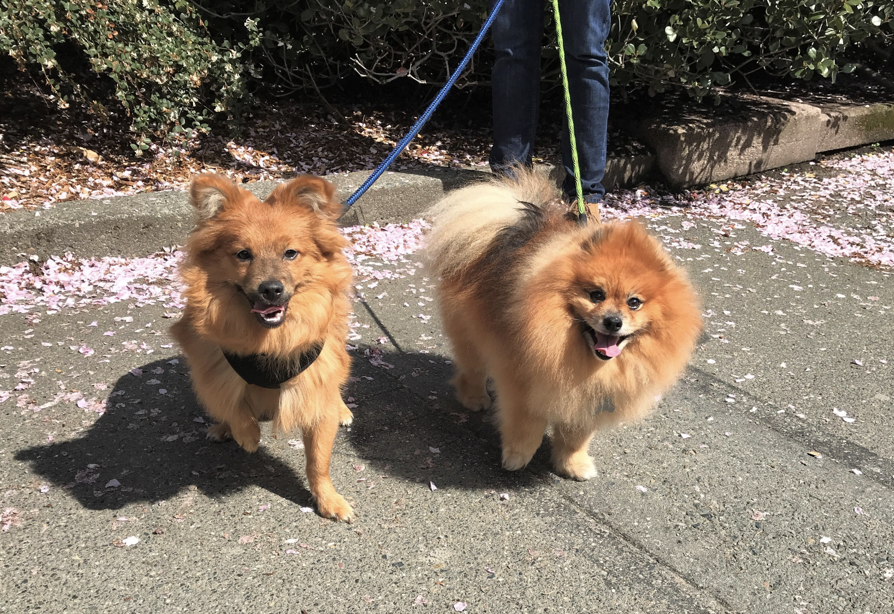

WHO ARE WE?

Slide 3
AGENDA
THE PROBLEM
OUR MISSION
OUR SOLUTION
DATABASE DESIGN
OUR APP

Slide 4









THE PROBLEM

Slide 5

OUR MISSION
CLINICS
VETS
OWNERS
CENTRALIZED REPOSITORY
COMPLETE AND ACCESSIBLE MEDICAL HISTORIES
FACILITATES COMMUNICATION
PetDB is a centralized repository of medical records for pets, with complete medical histories accessible to service providers and owners alike.
We are the leading application that facilitates communication between clinics, veterinarians, and owners.
We ensure medical records across facilities are in sync, whether that be scheduling or canceling vet appointments, keeping up to date with vaccines, or accessing a pet's medical history.

Slide 6



OUR SOLUTION
PetDB database
PetDB user application
Valuable insights for clinics, vets, and owners

Slide 7
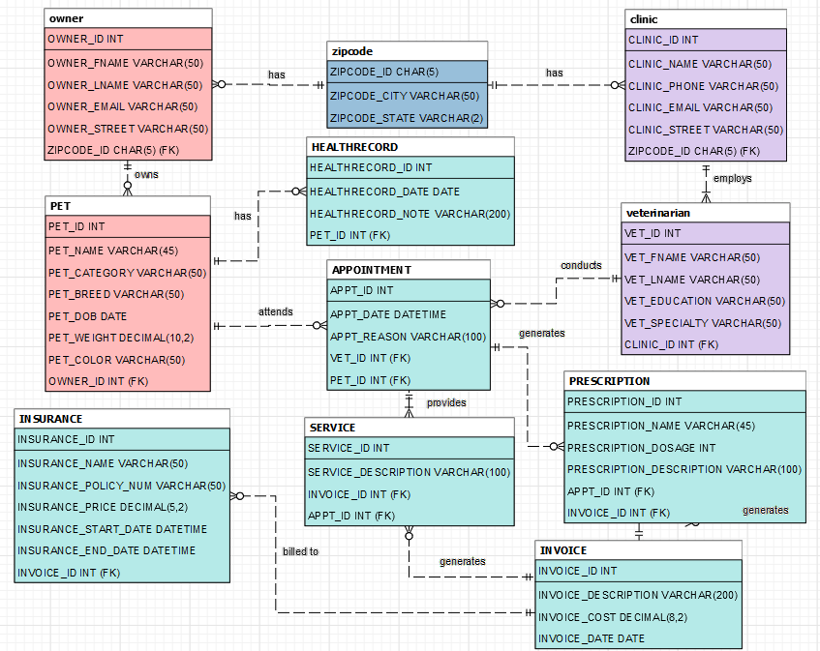
COMPLETE ERD

Slide 8

OUR APPLICATION

Slide 9

Q&A

